Slide 1

Social Media Analysis
Title:
Leveraging Instagram Data for Targeted Marketing Strategies.
Subtitle:
Insights and Recommendations for Boosting User Engagement, Retention, and Acquisition.
Vikas Upadhyay
18/11/2024

Slide 2
Problem Statement
You are hired as a data analyst at Meta and asked to collaborate with Marketing team. Marketing teams wants to leverage Instagram's user data to develop targeted marketing strategies that will increase user engagement, retention, and acquisition. Provide insights and recommendations to address the following objectives.

Slide 3
Introduction and Objectives
Meta Overview:
Founded in 2004 as Facebook, rebranded to Meta in 2021.
Vision: Building technologies to connect people, communities, and businesses.
Products include Facebook, Instagram, WhatsApp, and Oculus VR.
Instagram at Meta:
Instagram: A platform with 2 billion+ active users globally.
Focus: Visual storytelling, content sharing, and community engagement.
Critical tool for businesses to reach and engage audiences.
Key Focus Areas:
Develop data-driven marketing strategies.
Increase user engagement, retention, and acquisition.
Leverage insights from Instagram's user data to inform decisions.

Slide 4
Social Media Data Overview
Social Media Data Breakdown:
Users Table: Stores user information with unique IDs and creation timestamps.
Photos Table: Tracks user-uploaded photos with references to the uploader (user ID).
Comments Table: Stores comments on photos, linking them to the user and photo IDs.
Likes Table: Captures "likes" on photos with references to the user and photo IDs.
Follows Table: Tracks follower - followee relationships between users.
Tags Table: Maintains unique hashtags with associated creation timestamps.
Photo_Tags Table: Links photos to hashtags for multi-tagging functionality.

Slide 5
Analytical Approach and tools
Data Cleaning and Validation:
Identify and resolve duplicates or null values.
User Activity Analysis:
Distribution of posts, likes, and comments.
Segmentation of users by engagement levels.
Engagement Metrics Calculation:
Average tags per post.
Total likes, comments, and engagement rate per user.
Identify users with highest engagement.
Visualization:
Created dynamic charts for data representation, enabling interactive data exploration.

Slide 6
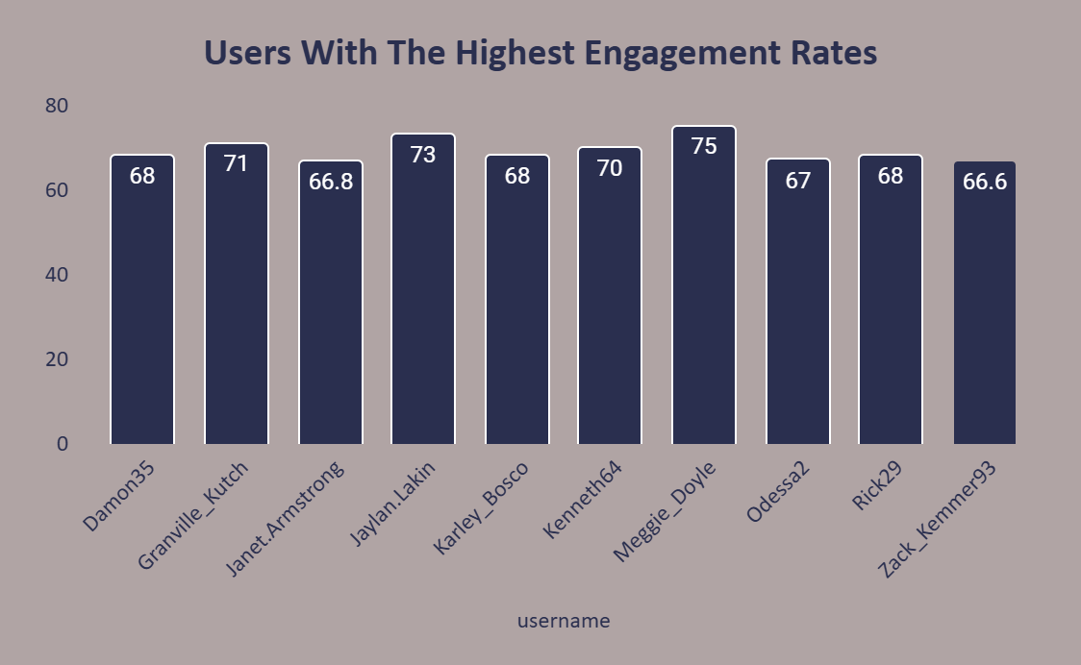
User Engagement Analysis
Purpose:
Identify top users with the highest engagement rates (likes, comments).
Insights:
Janet Armstrong and Zack Kemmer: High posts, low engagement—content strategy needs improvement.
Meggie Doyle, Jaylan Lakin, Granville Kutch: Few posts, high engagement—content strategy working well.

Slide 7
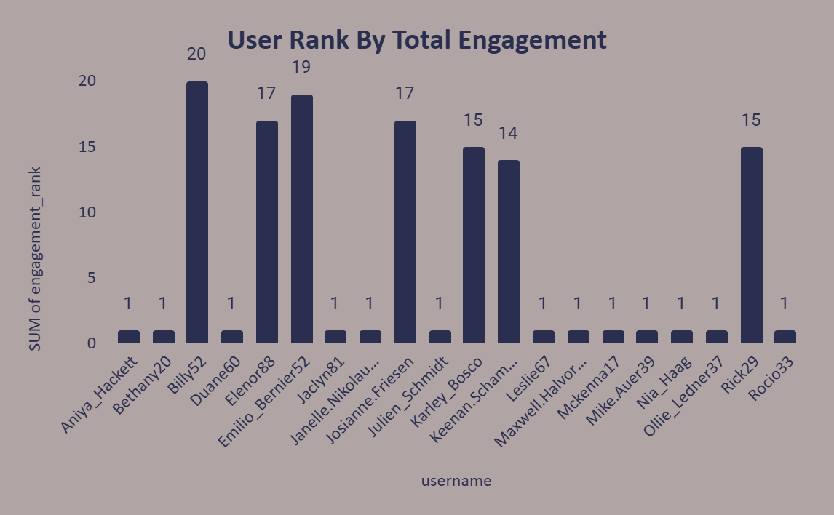
User Engagement By Month Analysis
Insights:
Billy52 (Rank 20) and Elenor88 (Rank 17): High engagement, strong influence.
Emilio_Bernier52 (Rank 19), Karley_Bosco, Rick29 (Rank 15): Great for targeted campaigns.
Aniya_Hackett, Bethany20, Nia_Haag: Low engagement, likely inactive or niche-focused.

Slide 8
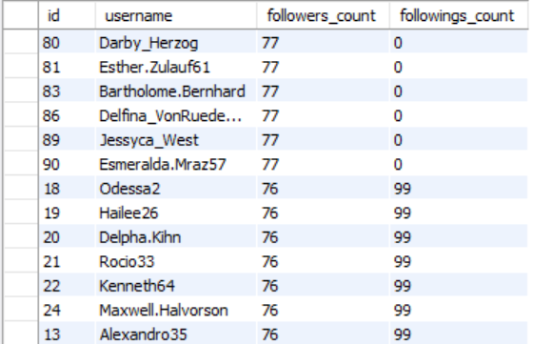
Followers And Following Analysis
Insights:
Kenton_Kirlin and Kasandra_Homenick: 77 followers, no followings—one-sided dynamics.
Odessa2 and Hailee26: 76 followers, 99 followings—reciprocal behavior.
Most users: Balanced 76 followers, 99 followings—uniform engagement pattern.

Slide 9
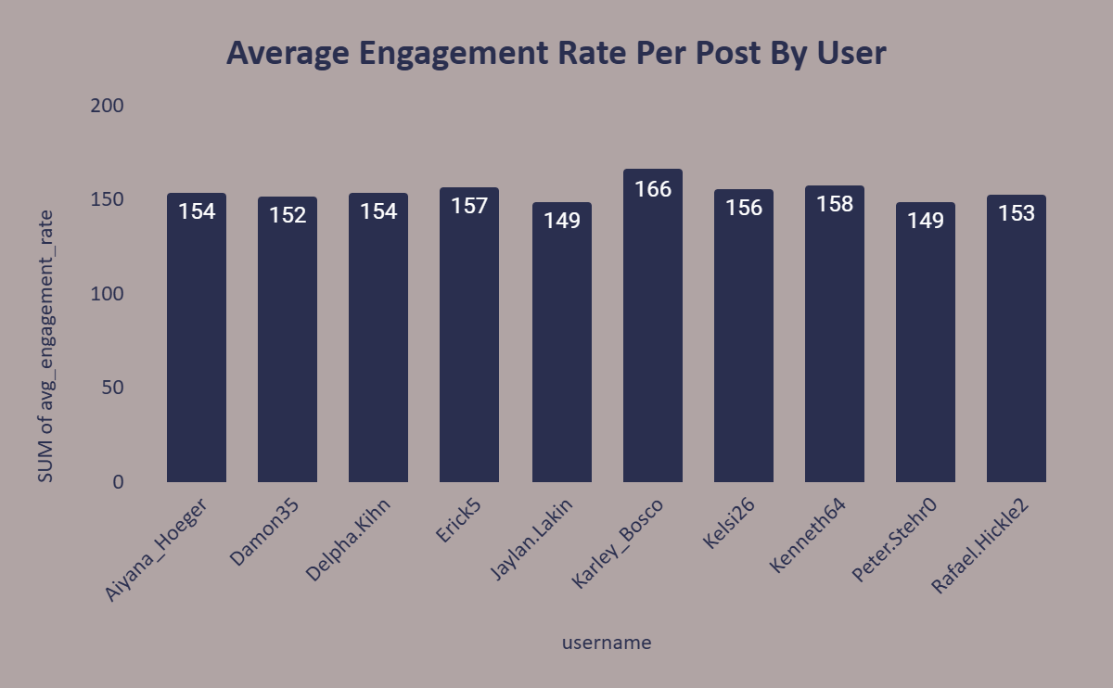
Average Engagement Rate Analysis
Insights:
Karley_Bosco (166%) and Kenneth64 (158%) lead with exceptional engagement.
High engagement (149%+) shows strong audience resonance.
Encourage more frequent posting to boost overall engagement.

Slide 10
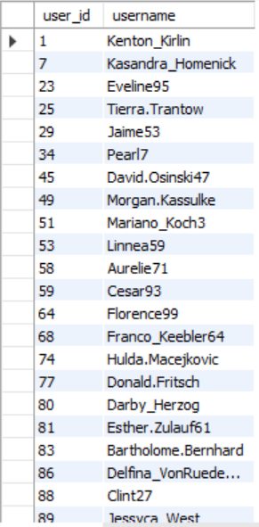
User Without Engagement Analysis
Insights:
The below table shows the list of users who have never liked any posts.
These users may represent inactive accounts or individuals who consume content but do not engage.
Some users might prefer passive participation rather than active engagement.

Slide 11
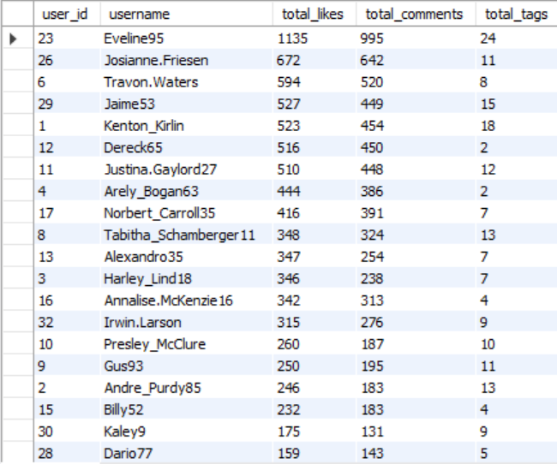
User by Engagement Analysis
Insights:
High likes/comments: Active, resonating contributors.
Low likes/comments: Opportunities for activation.
High tags: Ideal for theme-based campaigns.

Slide 12
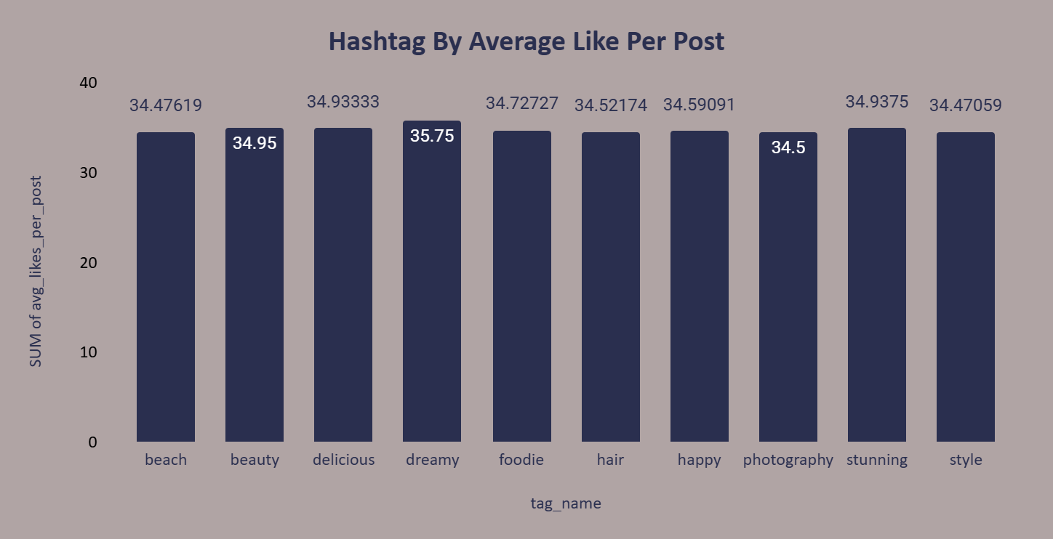
Hashtag by Average Likes Analysis
Insights:
The hashtags with the highest average likes per post are indicative of the most engaging topics or themes on the platform.
Use these popular hashtags to increase visibility and engagement for new posts or campaigns.

Slide 13
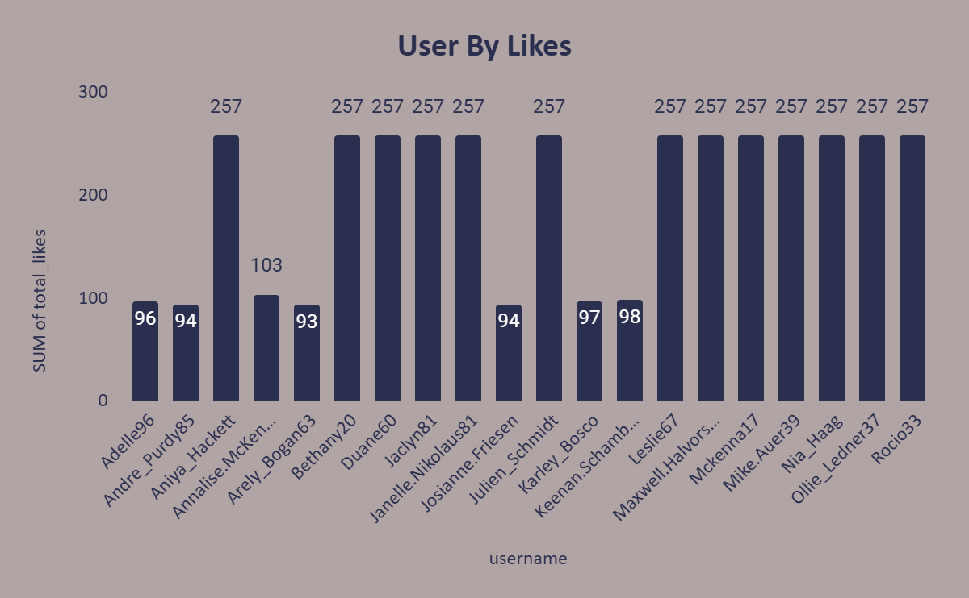
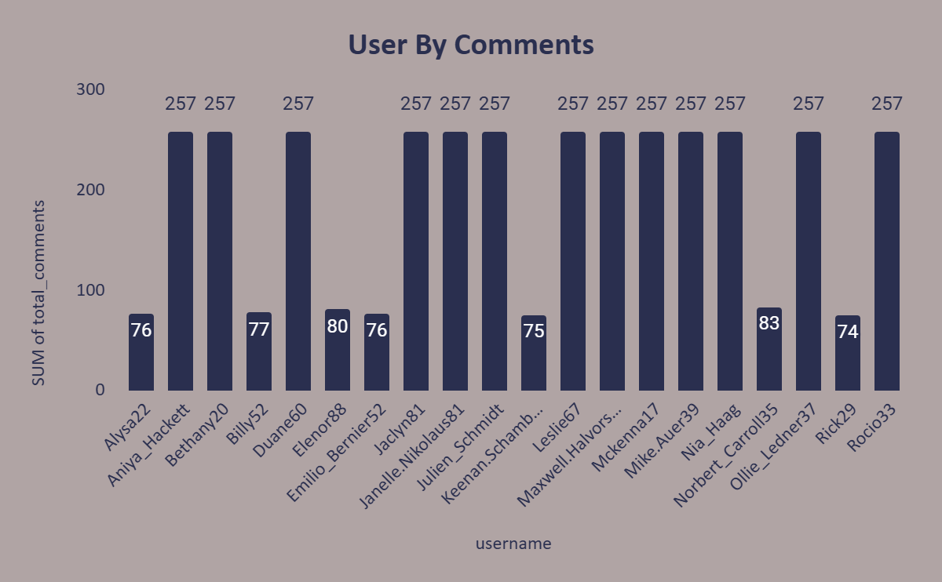
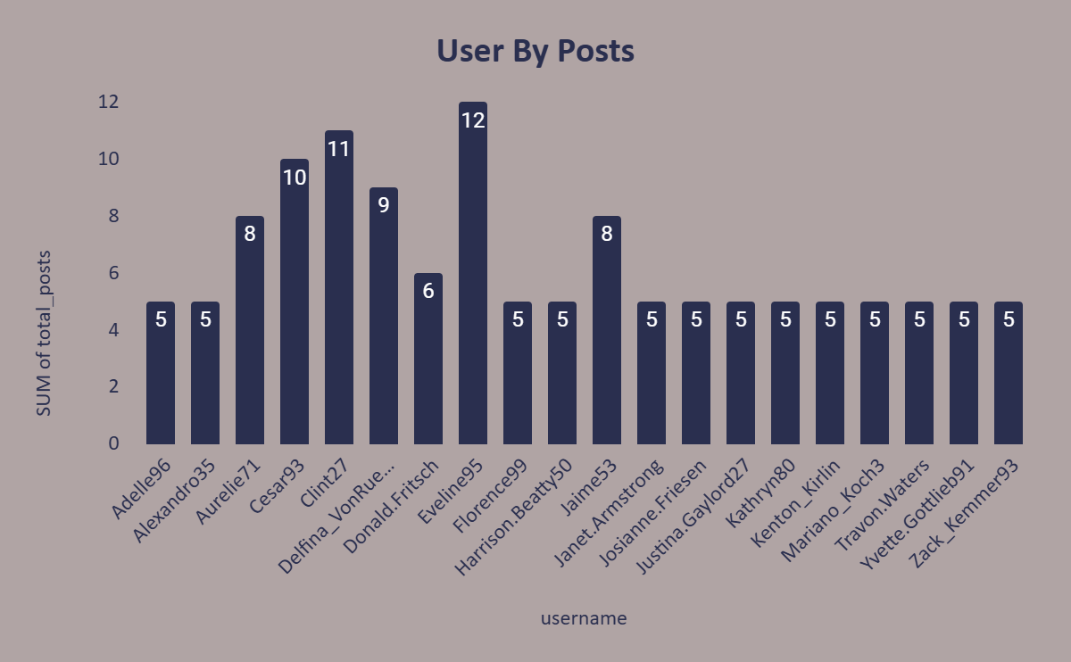
User Activity Analysis
Insights:
Some users with no posts but 257 likes/comments are active engagers.
Adelle96 and Josianne.Friesen show moderate posts with consistent engagement.
Karley_Bosco excels in engagement per post, highlighting quality content.
Users like Andre_Purdy85 may need guidance to improve post engagement.

Slide 14
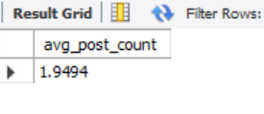
Average Tags Per Post Analysis
Insights:
The average number of tags per post is 1.9494.
This indicates that most users are not very active in terms of creating content.

Slide 15
Insights from Data Trends
High Engagement from Non-Posters:
Many users engage actively (likes, comments) without posting, highlighting potential for content creation incentives.
Low Average Post Count:
Low average post count (~1.95) suggests room to boost content creation.
Quality Over Quantity:
High engagement rates come from quality posts, not quantity, emphasizing content optimization.
Engagement Concentration:
Engagement is concentrated among a few active users, indicating influence opportunities.
Hashtag Strategy:
Hashtags positively impact engagement, offering a strategic focus for campaigns.

Slide 16
Subjective Feedback Analysis
Loyal/Valuable Users:
Define criteria for loyalty/engagement.
Suggested incentives.
Re-engaging Inactive Users:
Content refresh ideas.
Targeted campaigns.
High Engagement Hashtags/Topics:
Recommendations for content strategy.
How to use these for ad campaigns.

Slide 17
Subjective Feedback Analysis
Trends and Patterns in Engagement:
Analysis by demographics (age, gender, location).
Optimal posting times for campaigns.
Influencer Marketing Candidates:
Criteria: High engagement, loyal followers.
Collaboration approaches.
Continuous Monitoring.
Brand Ambassadors:
Identify active, highly engaged users to promote initiatives.
User Segmentation:
Target active creators, passive engagers, and inactive users with tailored strategies.

Slide 18
Engagement Metrics
Total:
Likes, comments, photo tags per user.
Monthly engagement rankings.
Segmentation based on behavior and engagement data:
Active users.
Influencers.
Potential advocates.

Slide 19
Strategic Recommendation
Re-engagement Campaigns:
Encourage activity from inactive users.
Leverage personalized notifications and incentives.
Content Strategy:
Analyze hashtags and topics with high engagement rates.
Recommend optimal posting times based on trends.
Influencer Marketing:
Identify top users with high engagement and followers.
Approach influencers for campaigns.

Slide 20
Recommendation
Targeted Campaigns:
Utilize trends in hashtags and posting times.
Focus on high-engagement content types.
Personalization:
Use user-generated content (UGC).
Leverage hashtags and photo tags for ad campaigns.
Brand Ambassadors:
Identify and collaborate with advocates.
Reward high-engagement users with exclusive offers.

Slide 21
Why Data Driven Approach Matters
Personalization:
Tailored content for each user’s interests and activity patterns.
Business Growth:
Increased ROI through targeted ads and strategic campaigns.
Community Building:
Enhancing connections between users and brands on Instagram.

Slide 22
Technical Implementation
Technical Implementation from Data:
Changing ‘Like’ to ‘Heart’:
Boost engagement with emotive interactions.
Engagement Metrics:
Track and analyze likes, shares, and trends weekly.
Demographics Correlations:
Personalize content based on user activity patterns.
Follower-Following Dynamics:
Promote reciprocal connections; identify influencers.

Slide 23
Conclusion
Insights from Data Drive:
Stronger Engagement Strategies:
Foster meaningful interactions.
Improved User Retention and Acquisition:
Targeted content for growth.
Feedback Loops:
Drive iterative improvements.
Campaign Optimization :
Regular analysis for better performance.

